Slide 1
African Safari!

Slide 2
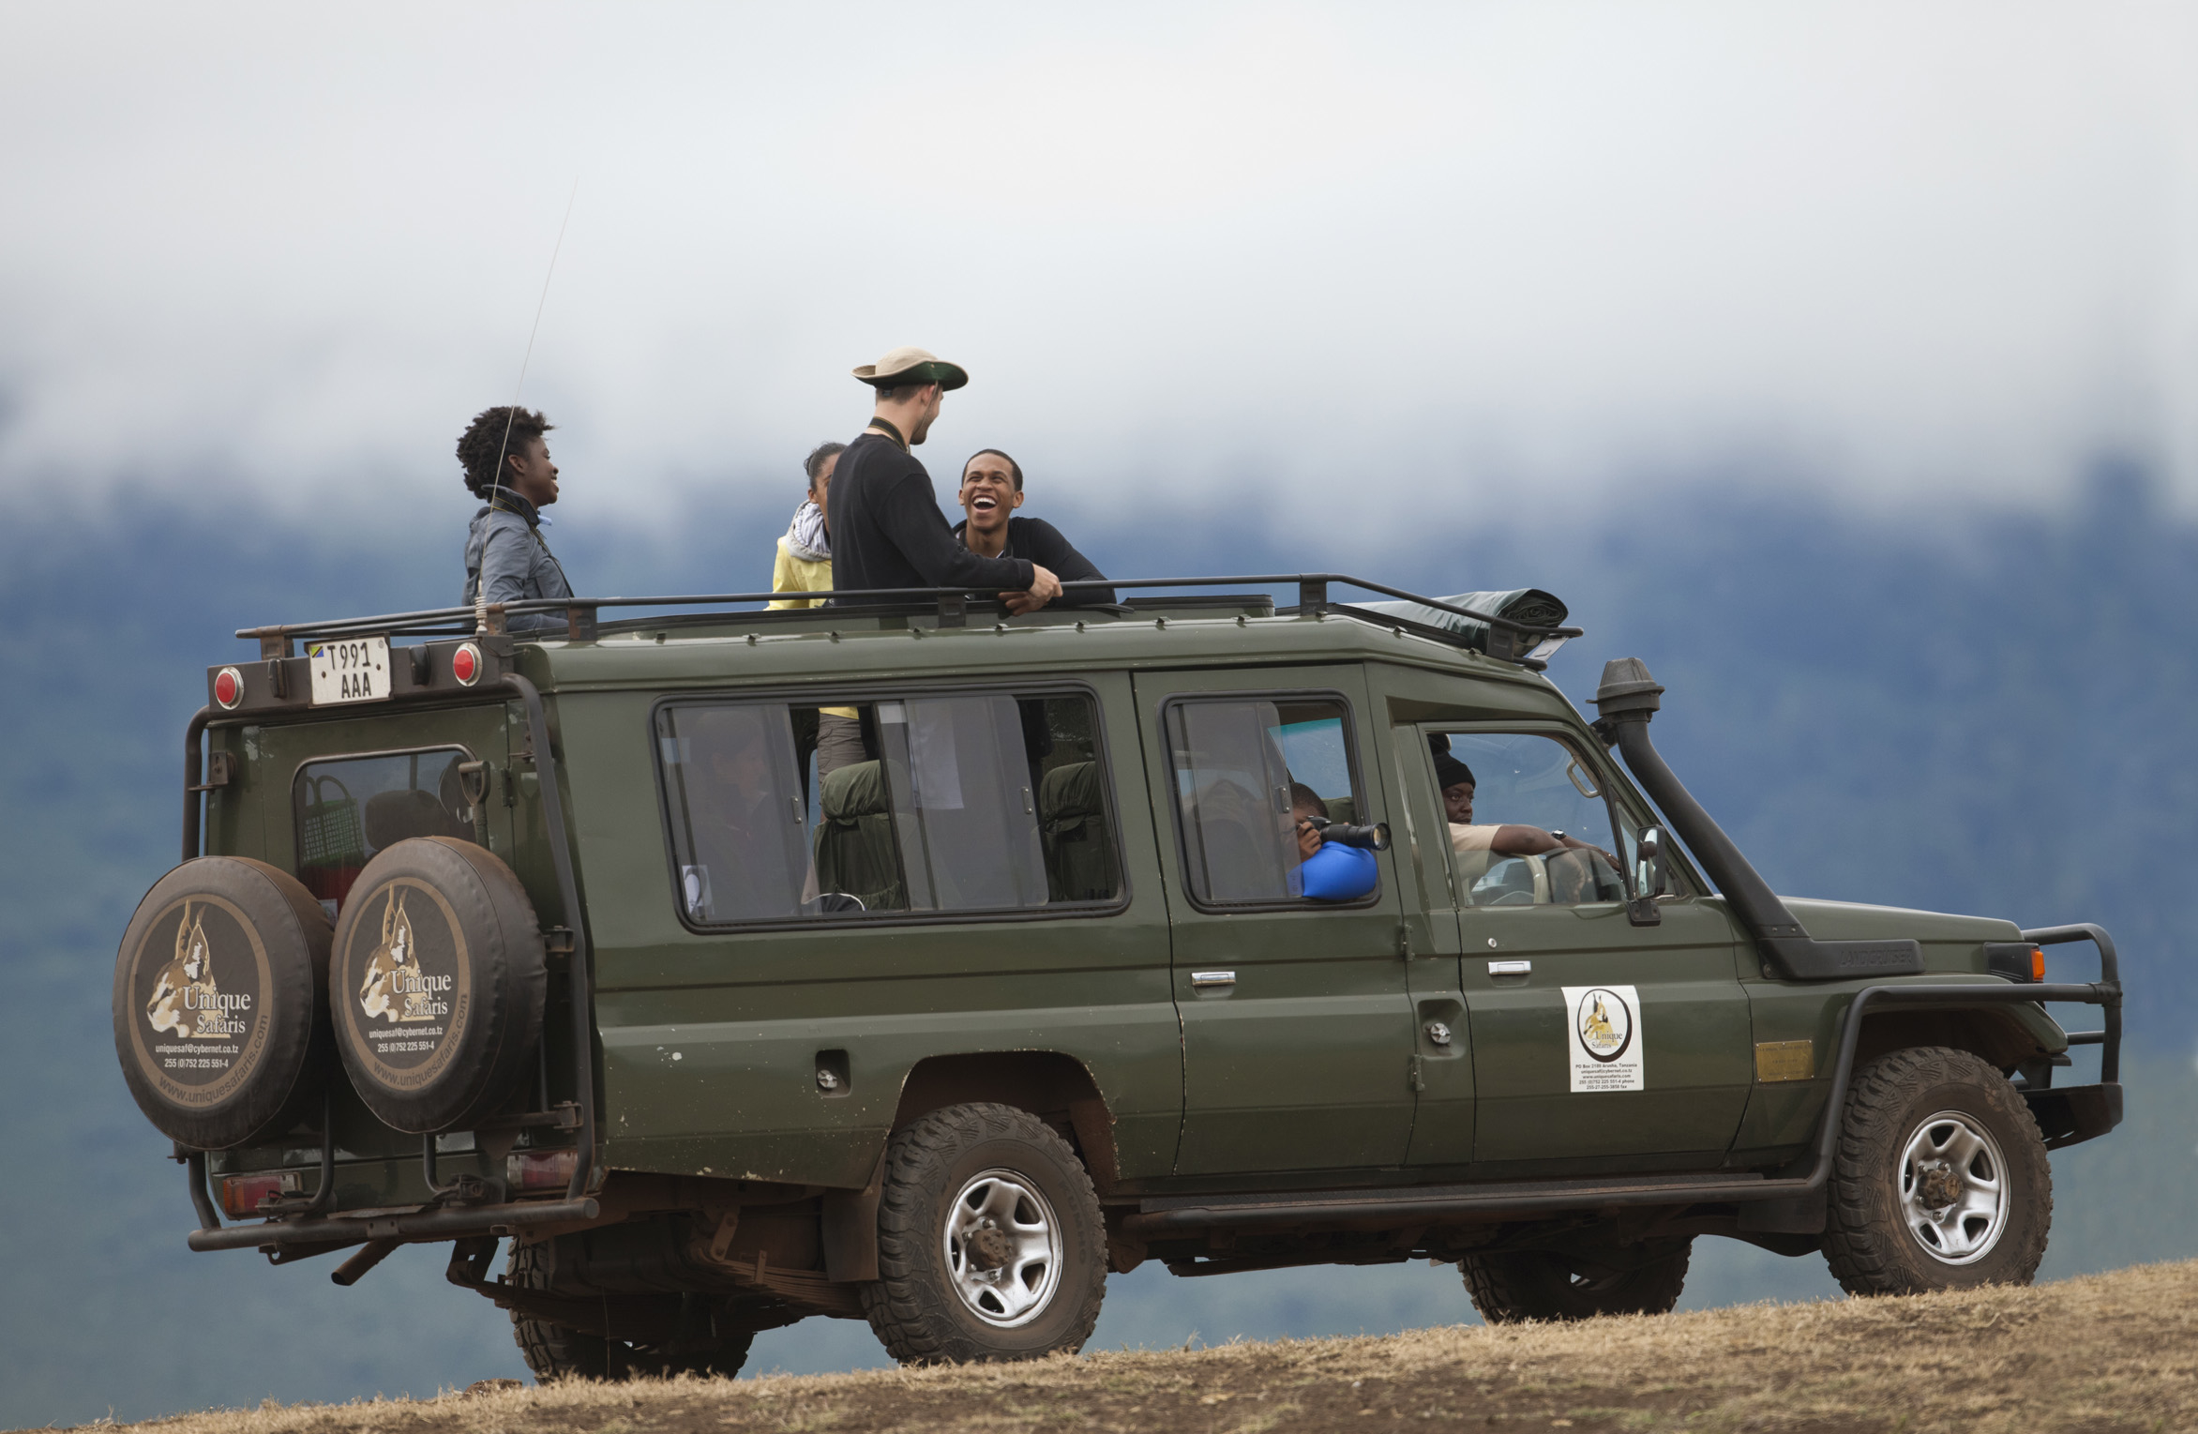

Move: Safari Hat Ready
Notes:
http://www.resilientcarhire.com/wp-content/uploads/2014/09/tours1.jpg

Slide 3
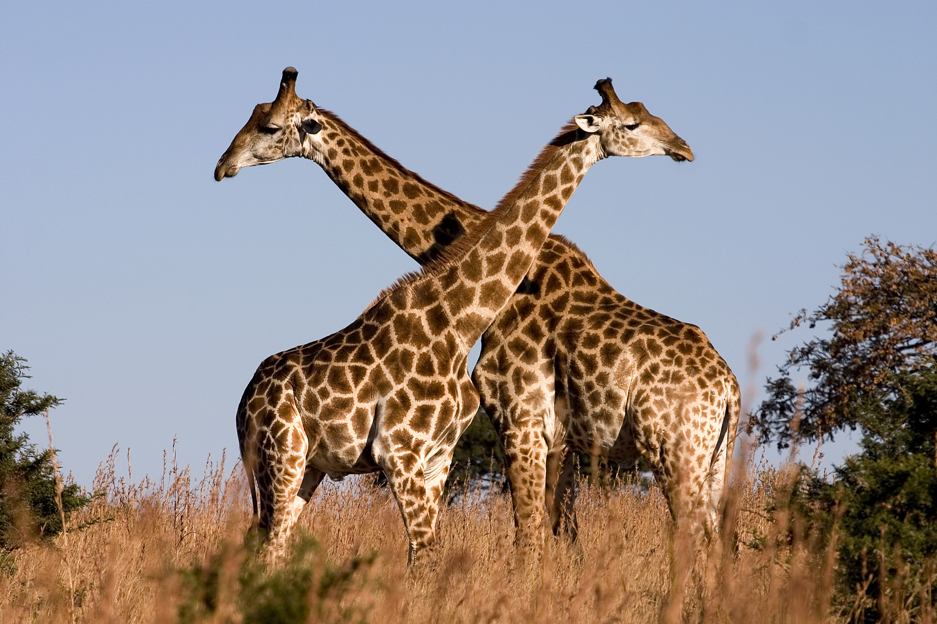
Move: Reach for the Sky
Notes:
https://upload.wikimedia.org/wikipedia/commons/0/02/Giraffe_Ithala_KZN_South_Africa_Luca_Galuzzi_2004.JPG

Slide 4
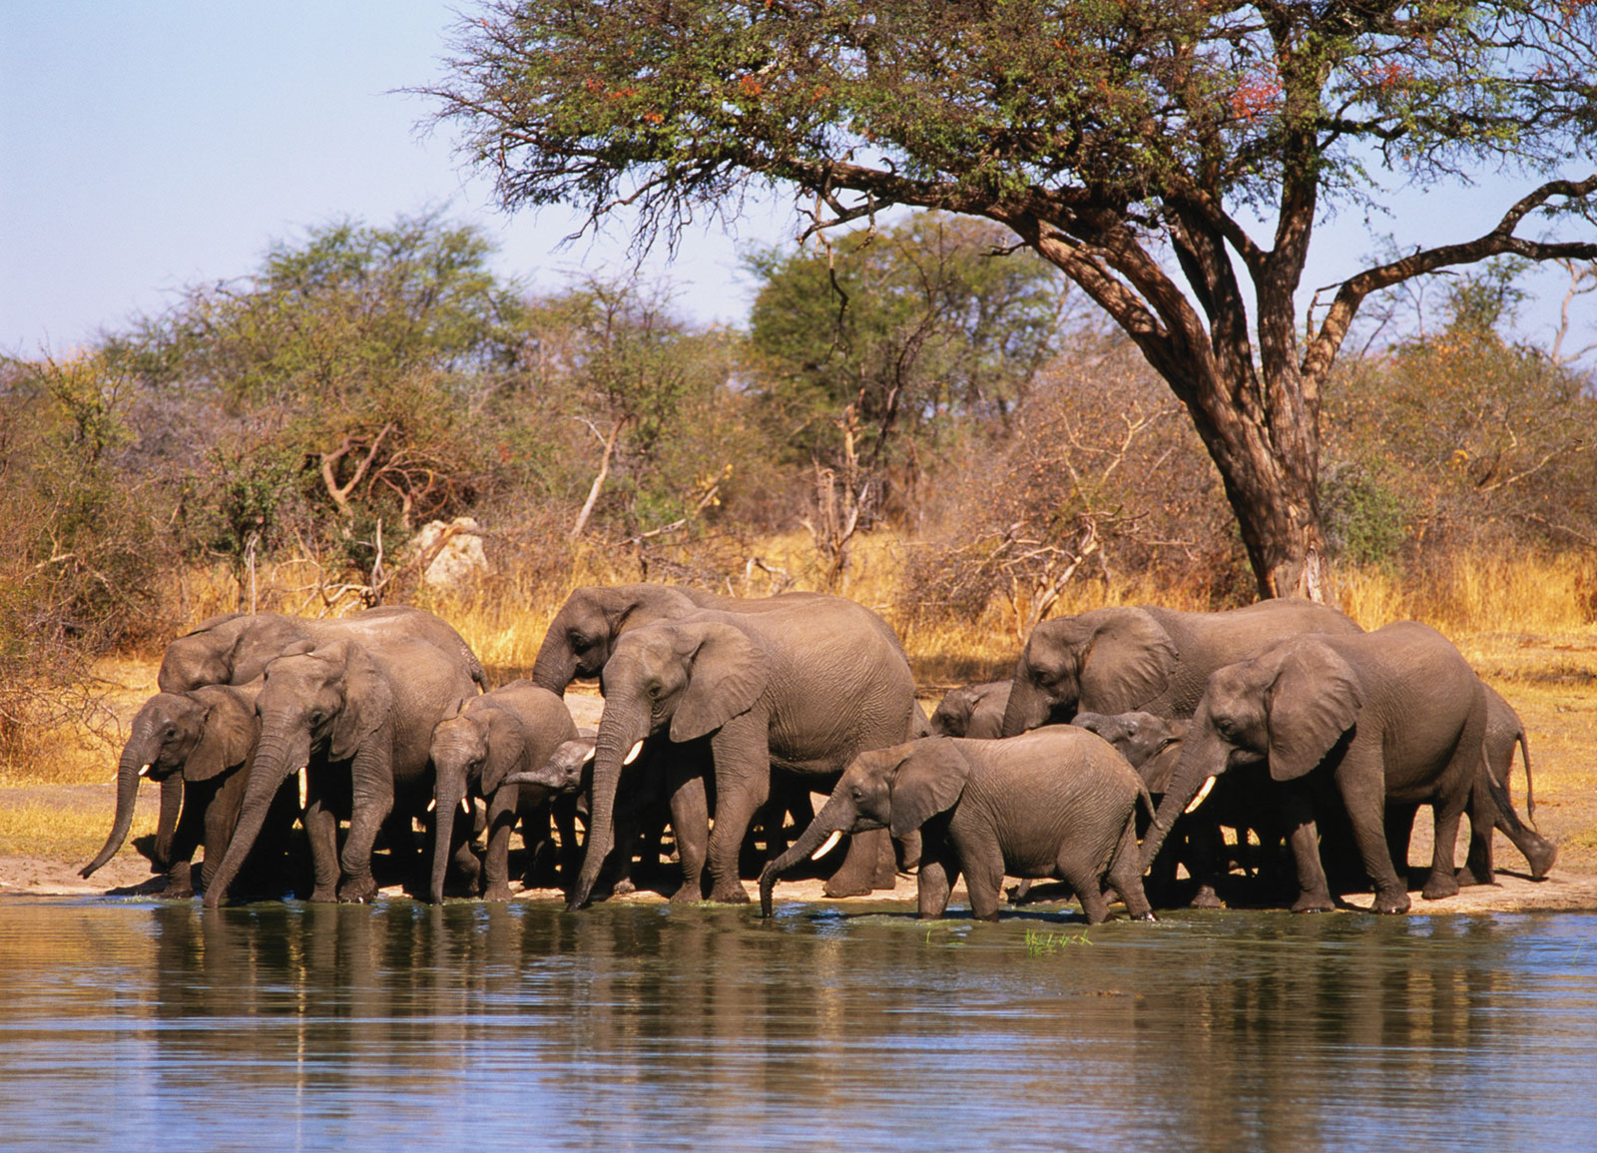
Move: Trunk Wave
Notes:
http://media.web.britannica.com/eb-media/73/62173-050-95E2EBF2.jpg

Slide 5
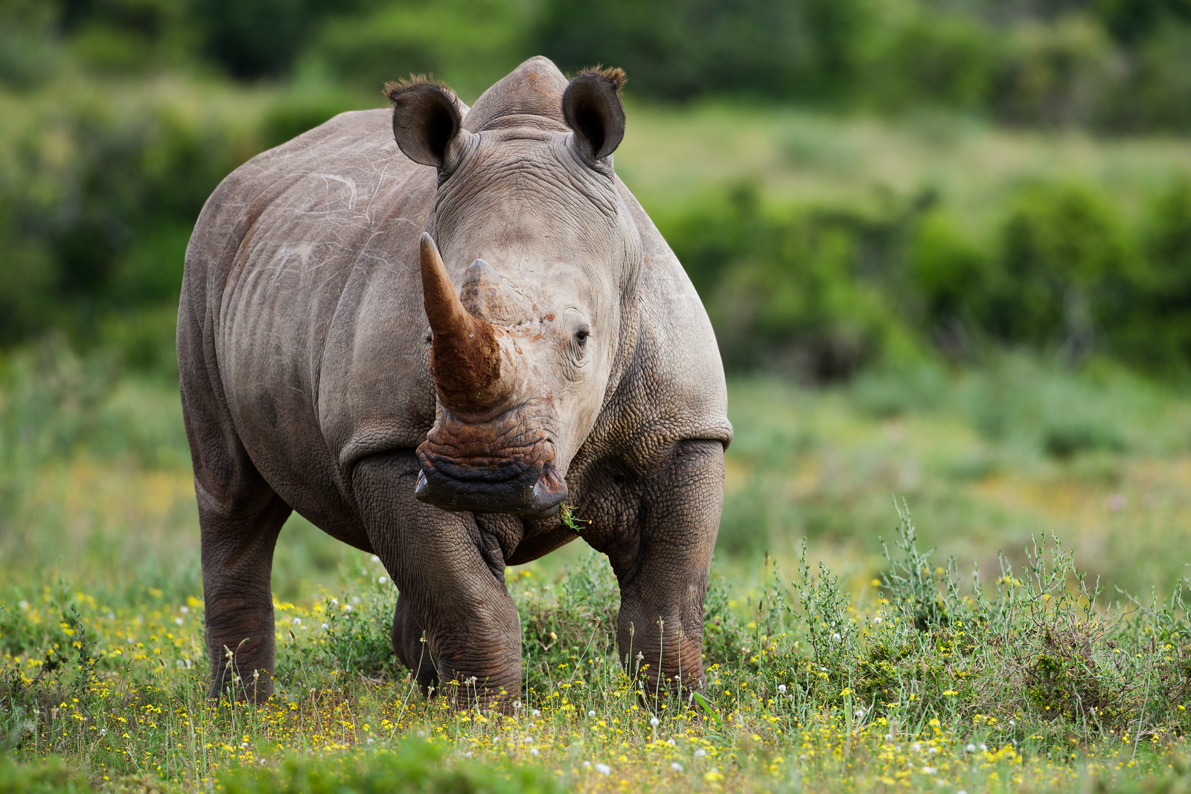
Move: Rhinoceros Charge
Notes:
http://12hours.co.za/wp-content/uploads/2013/05/kariega-white-rhino.jpg

Slide 6
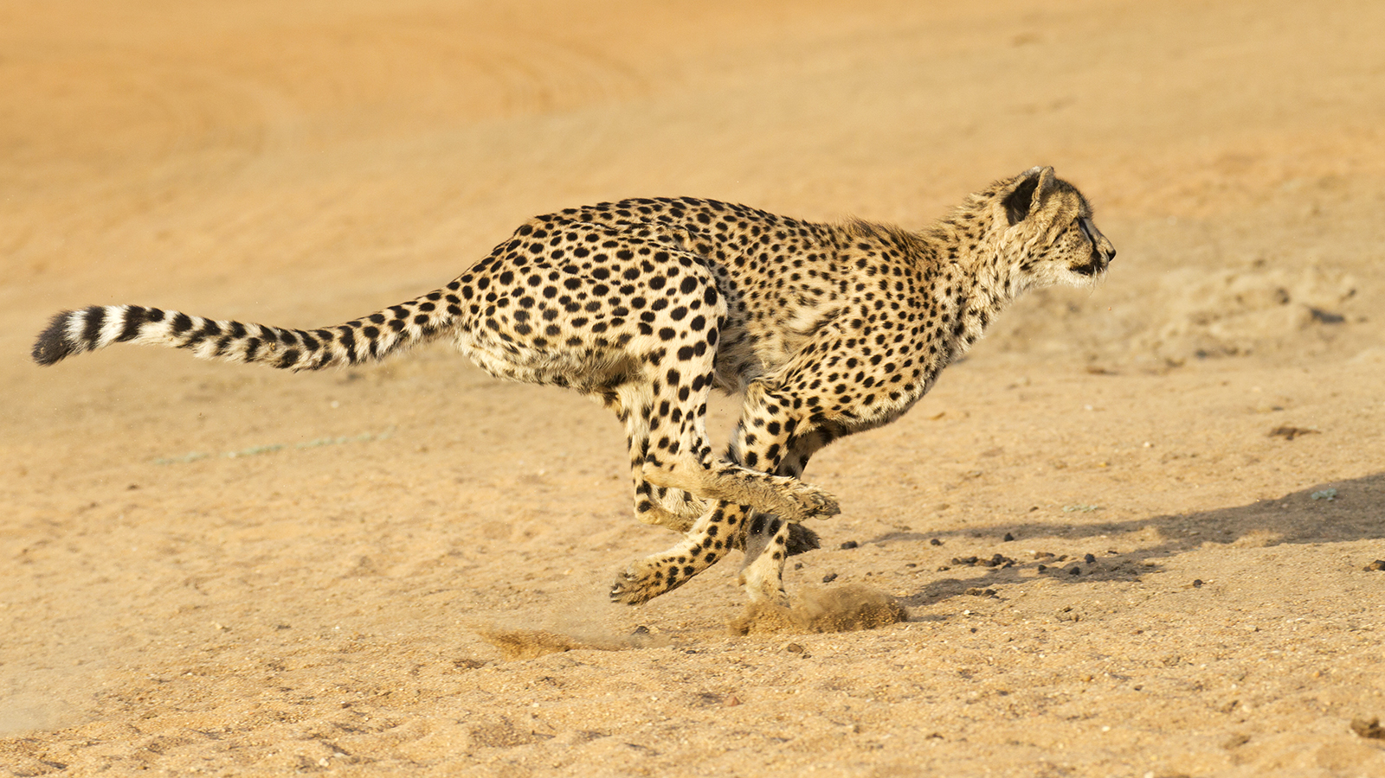
Move: Cheetah Sprint
Notes:
http://kids.nationalgeographic.com/content/dam/kids/photos/animals/Mammals/A-G/cheetah-running.jpg

Slide 7
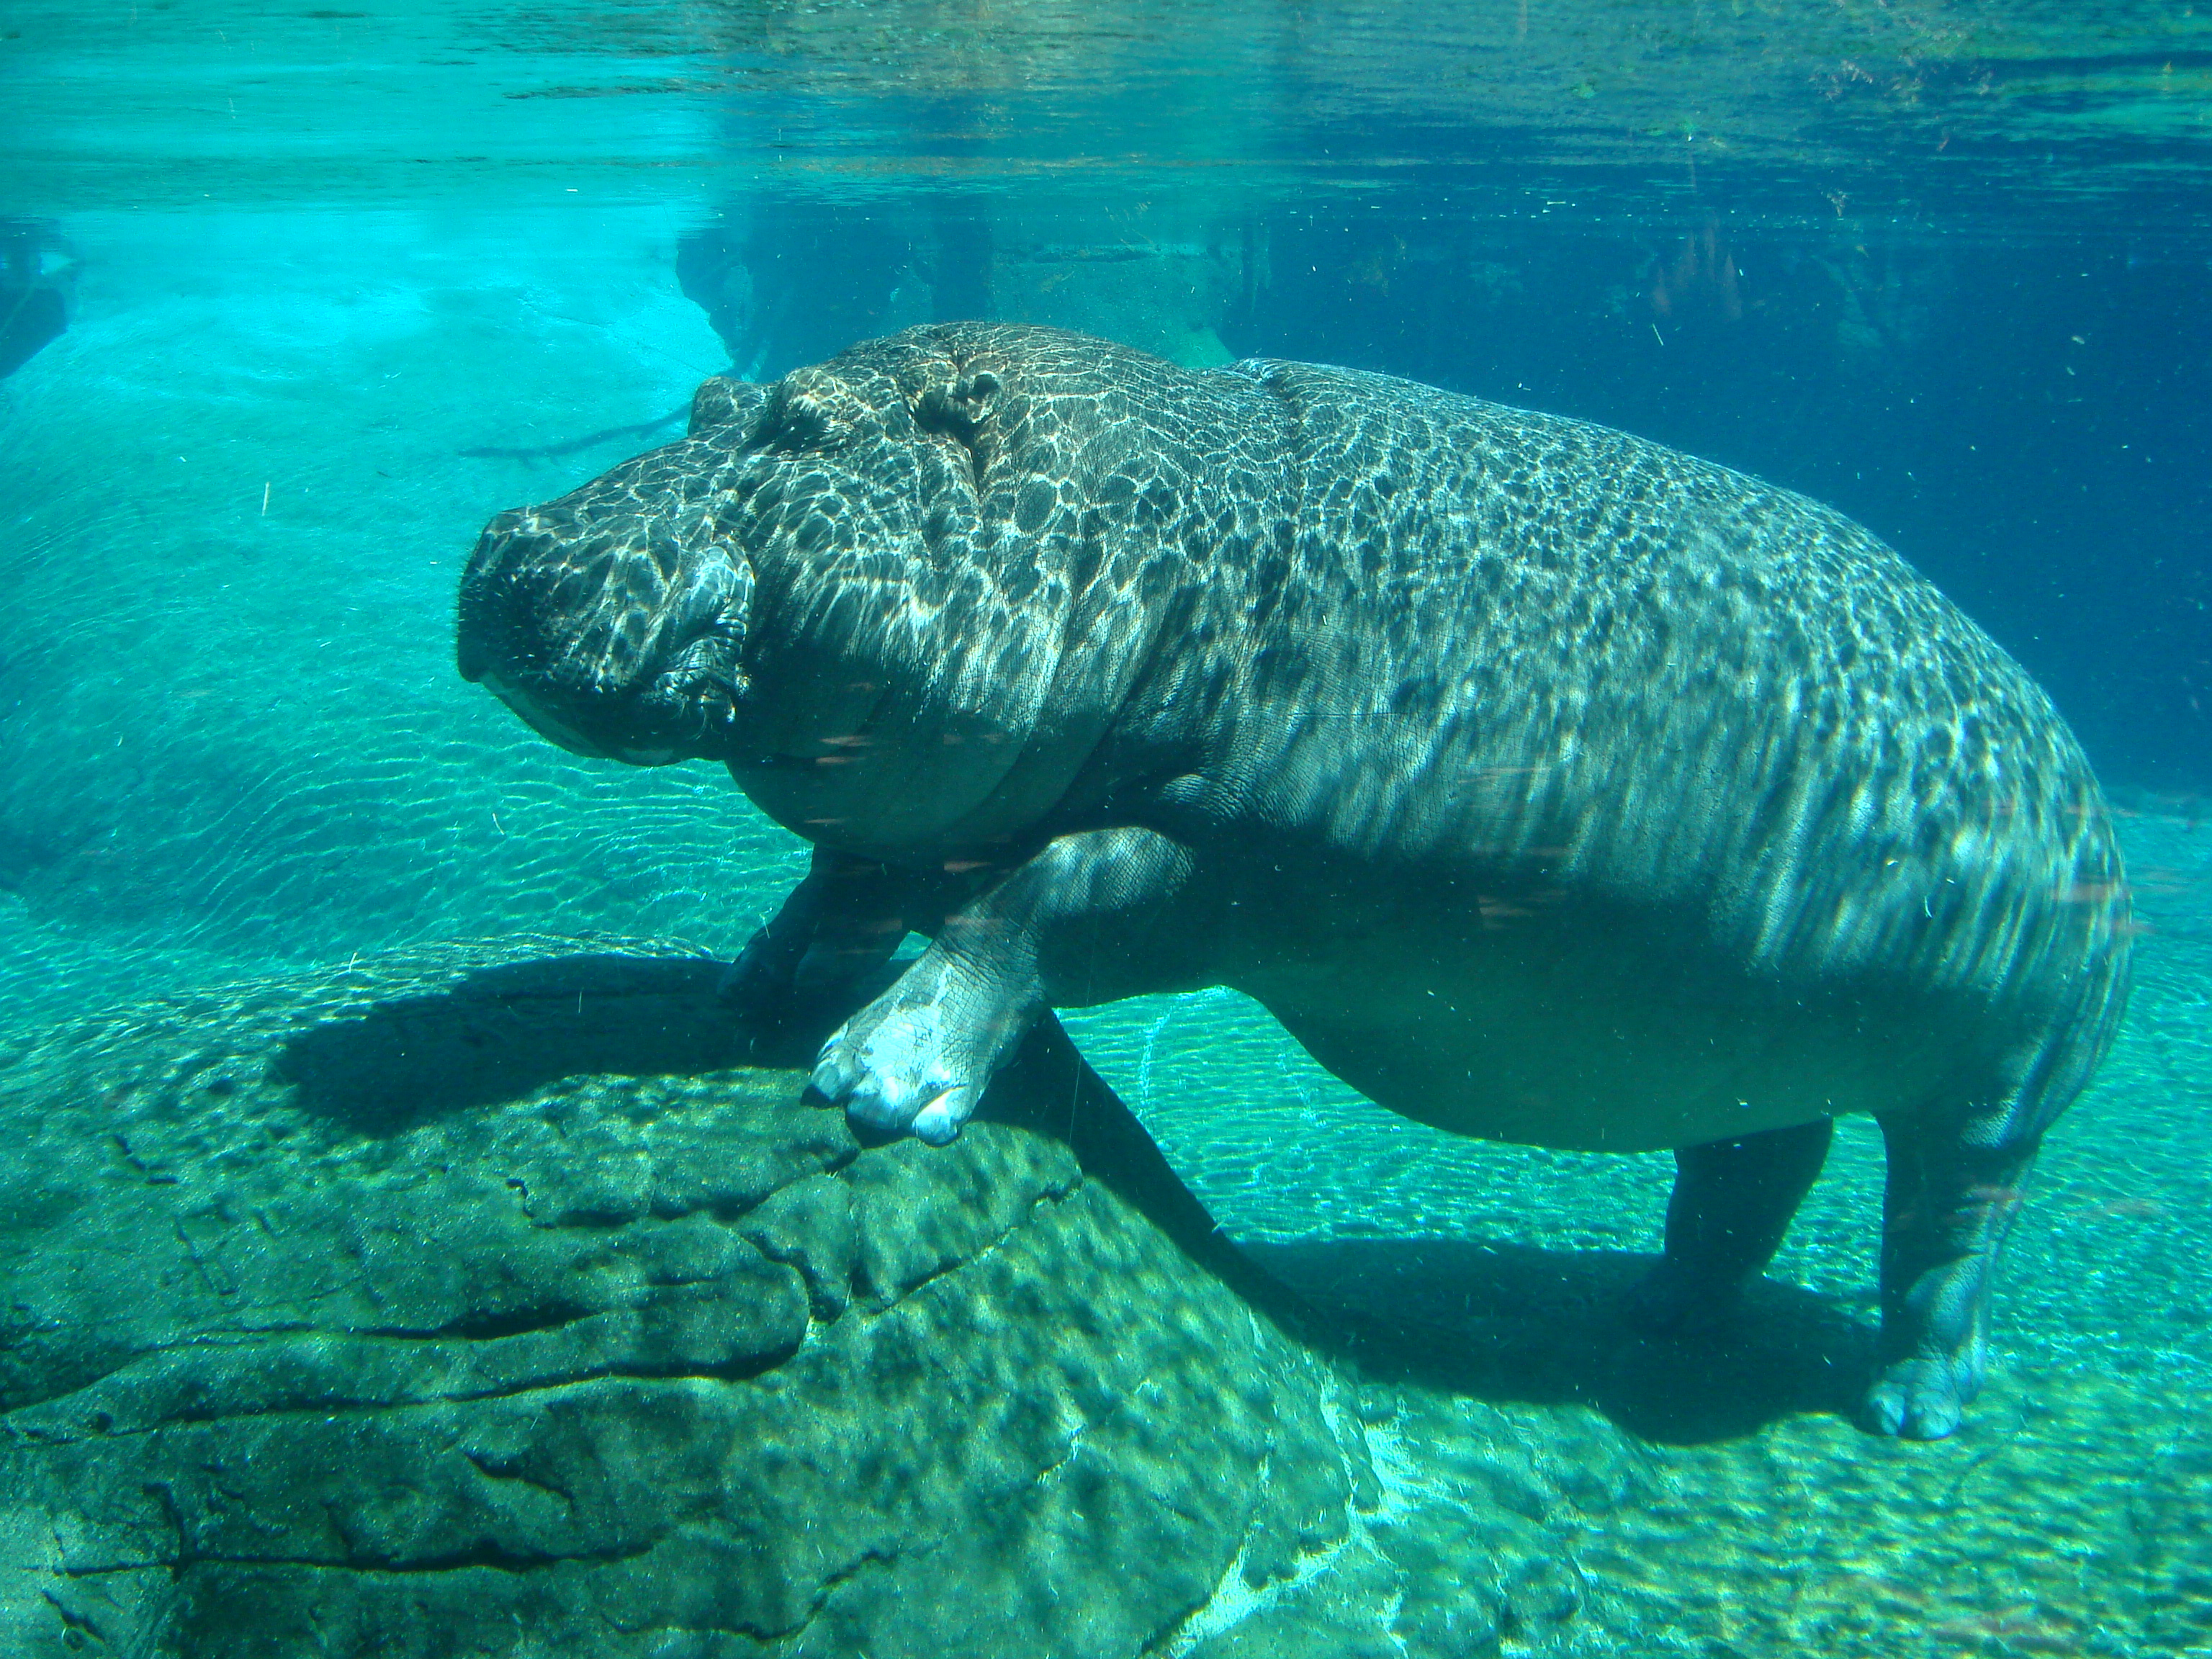
Move: Hippo’s Mouth
Notes:
https://upload.wikimedia.org/wikipedia/commons/f/fa/Hippopotamus_in_San_Diego_Zoo.jpg

Slide 8
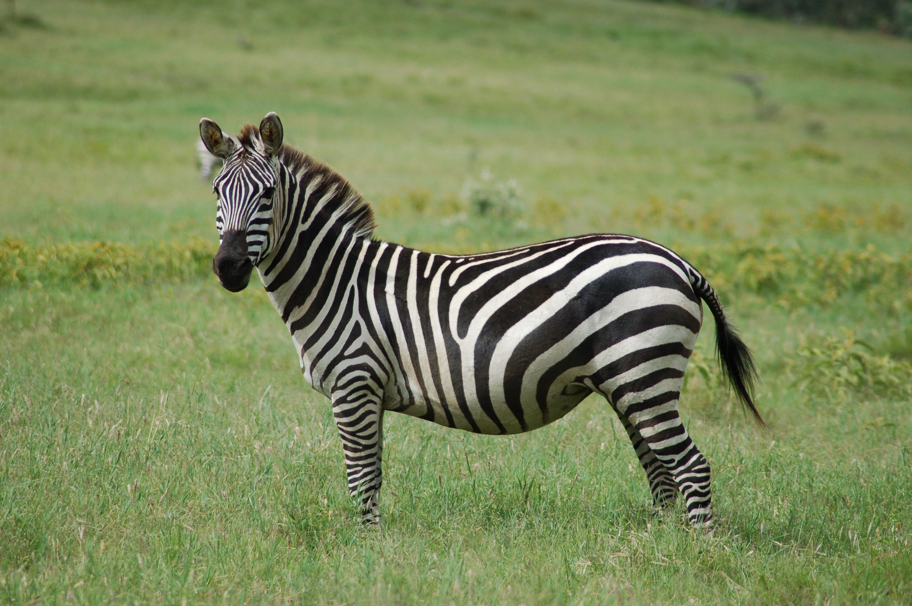
Move: Zebra Walk
Notes:
https://upload.wikimedia.org/wikipedia/commons/6/60/Equus_quagga.jpg

Slide 9
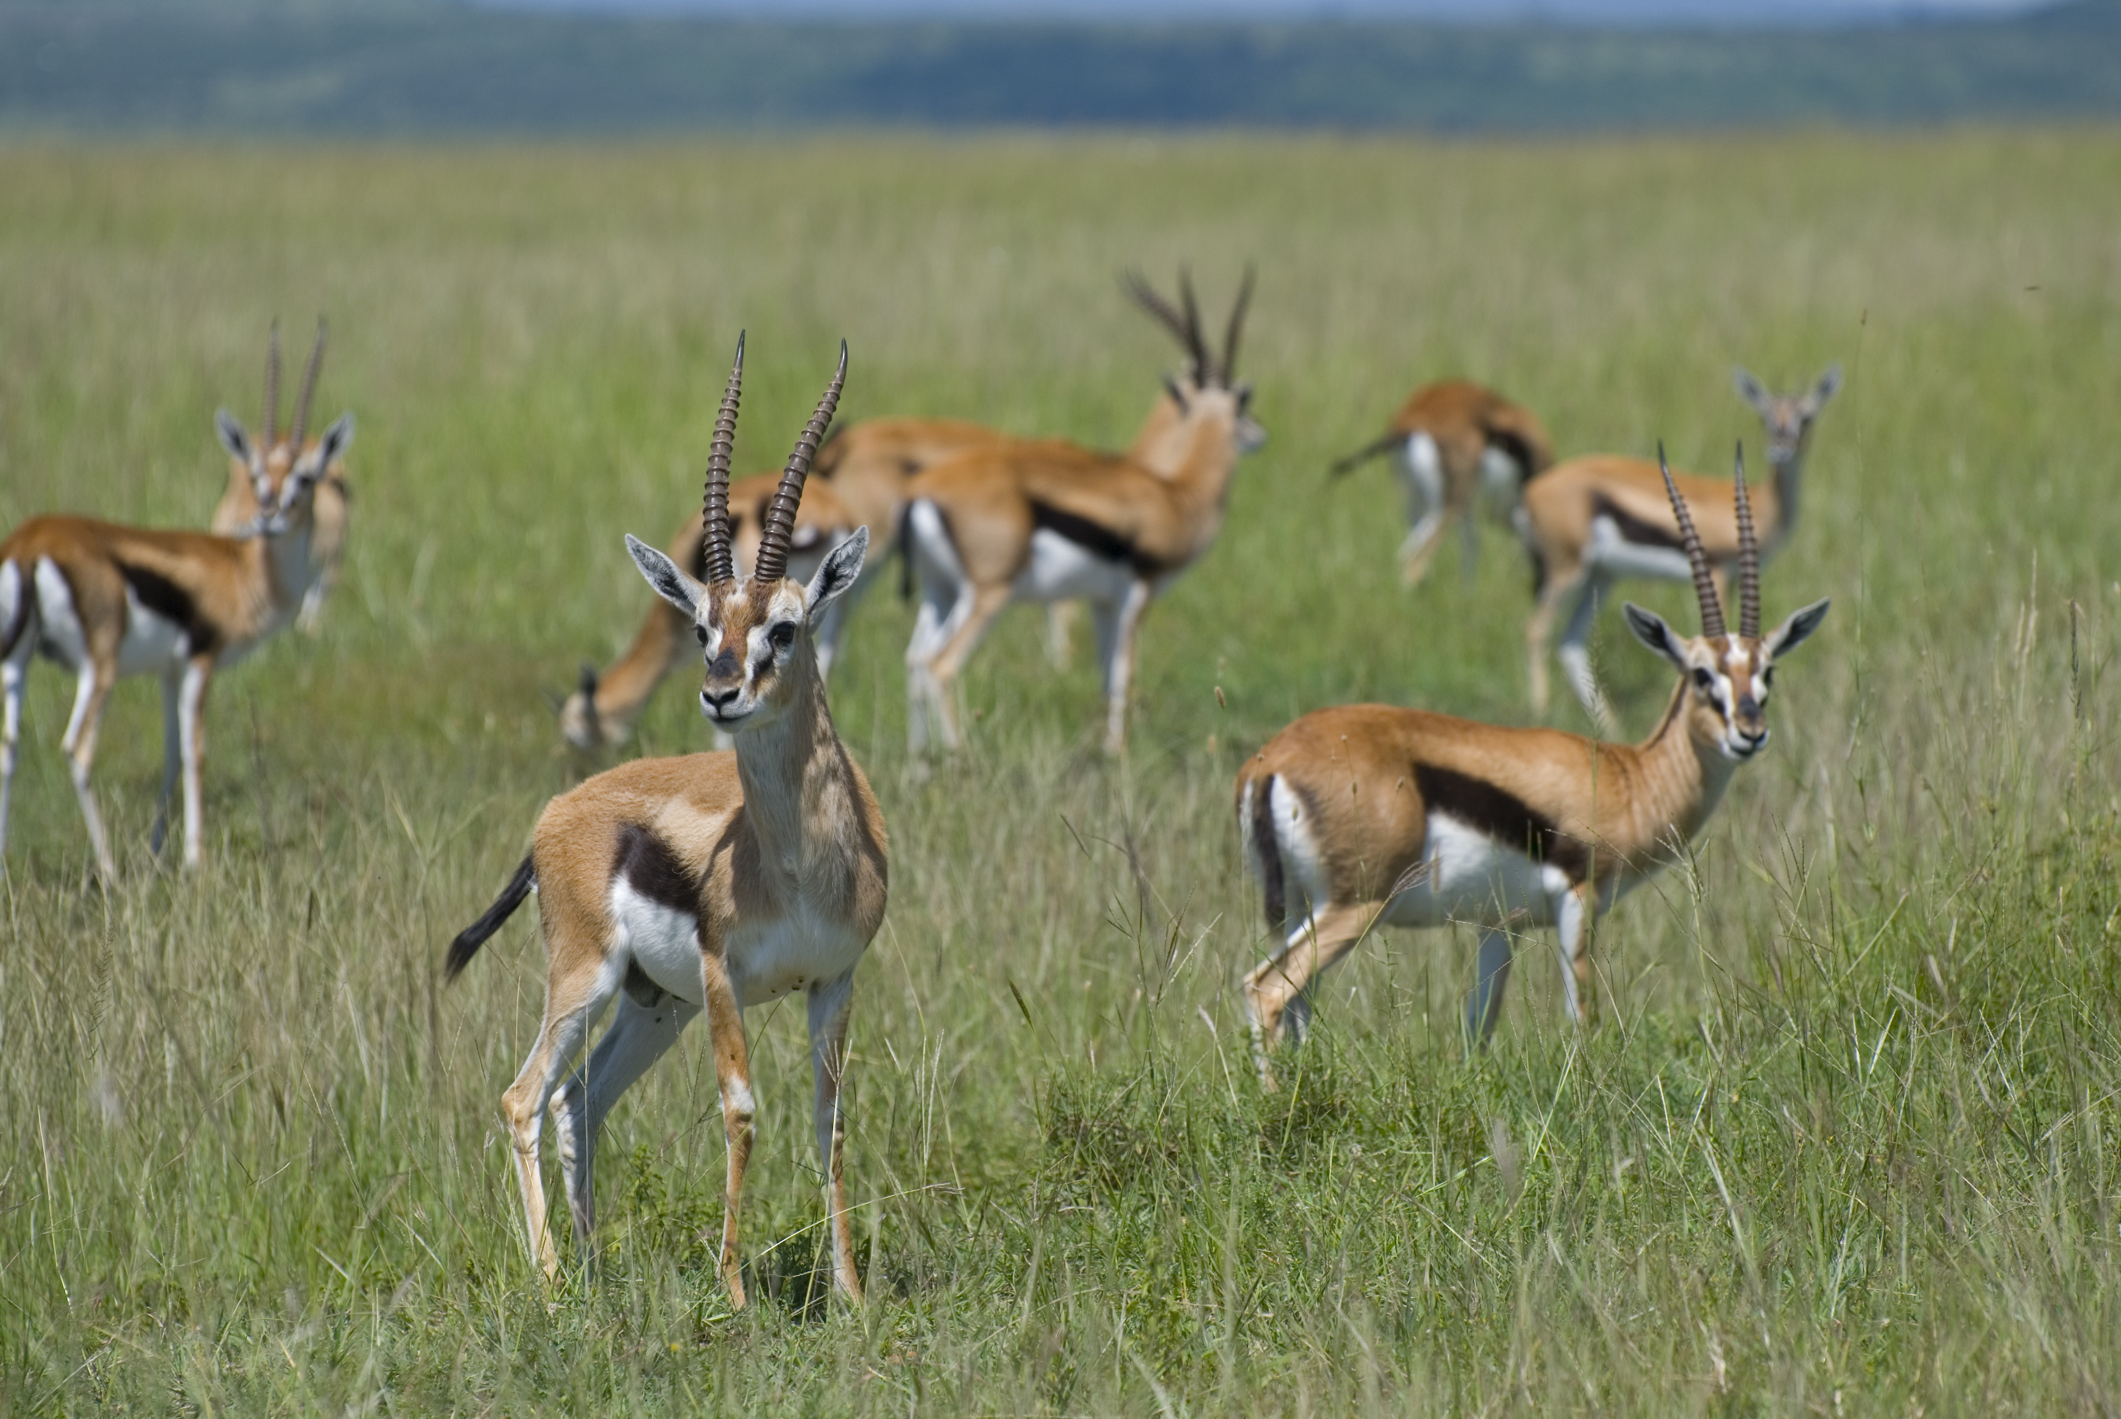
Move: Graceful Gazelle
Notes:
https://upload.wikimedia.org/wikipedia/commons/6/64/Gazella_thomsoni_in_Masai_Mara.jpg

Slide 10
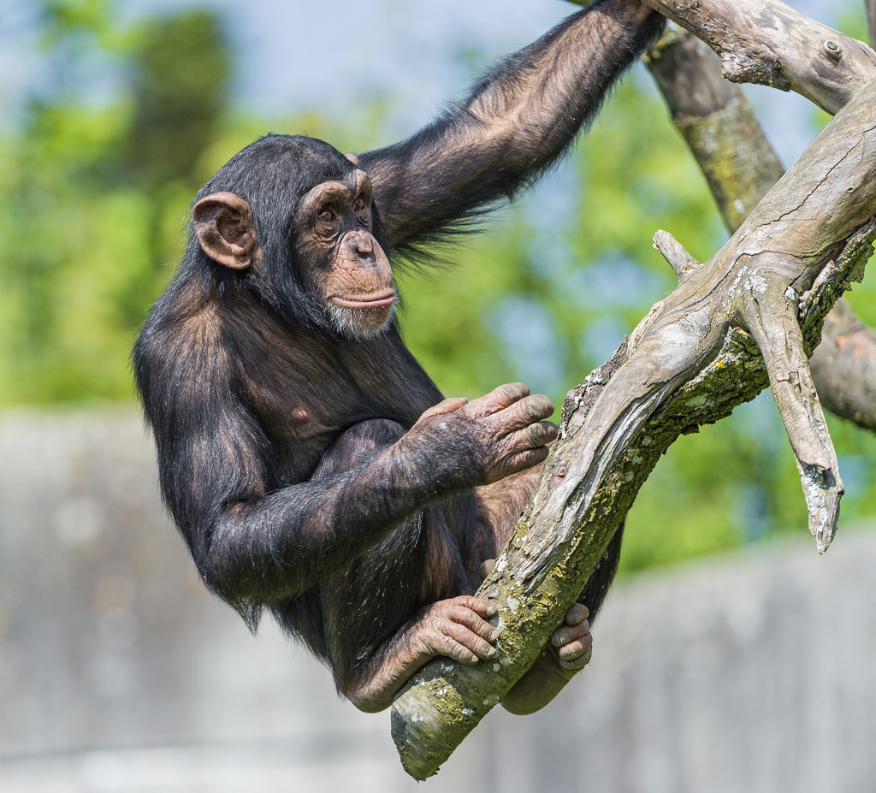
Move: Tree Climbing
Notes:
https://c2.staticflickr.com/8/7362/9905545703_99f34f3087_b.jpg

Slide 11
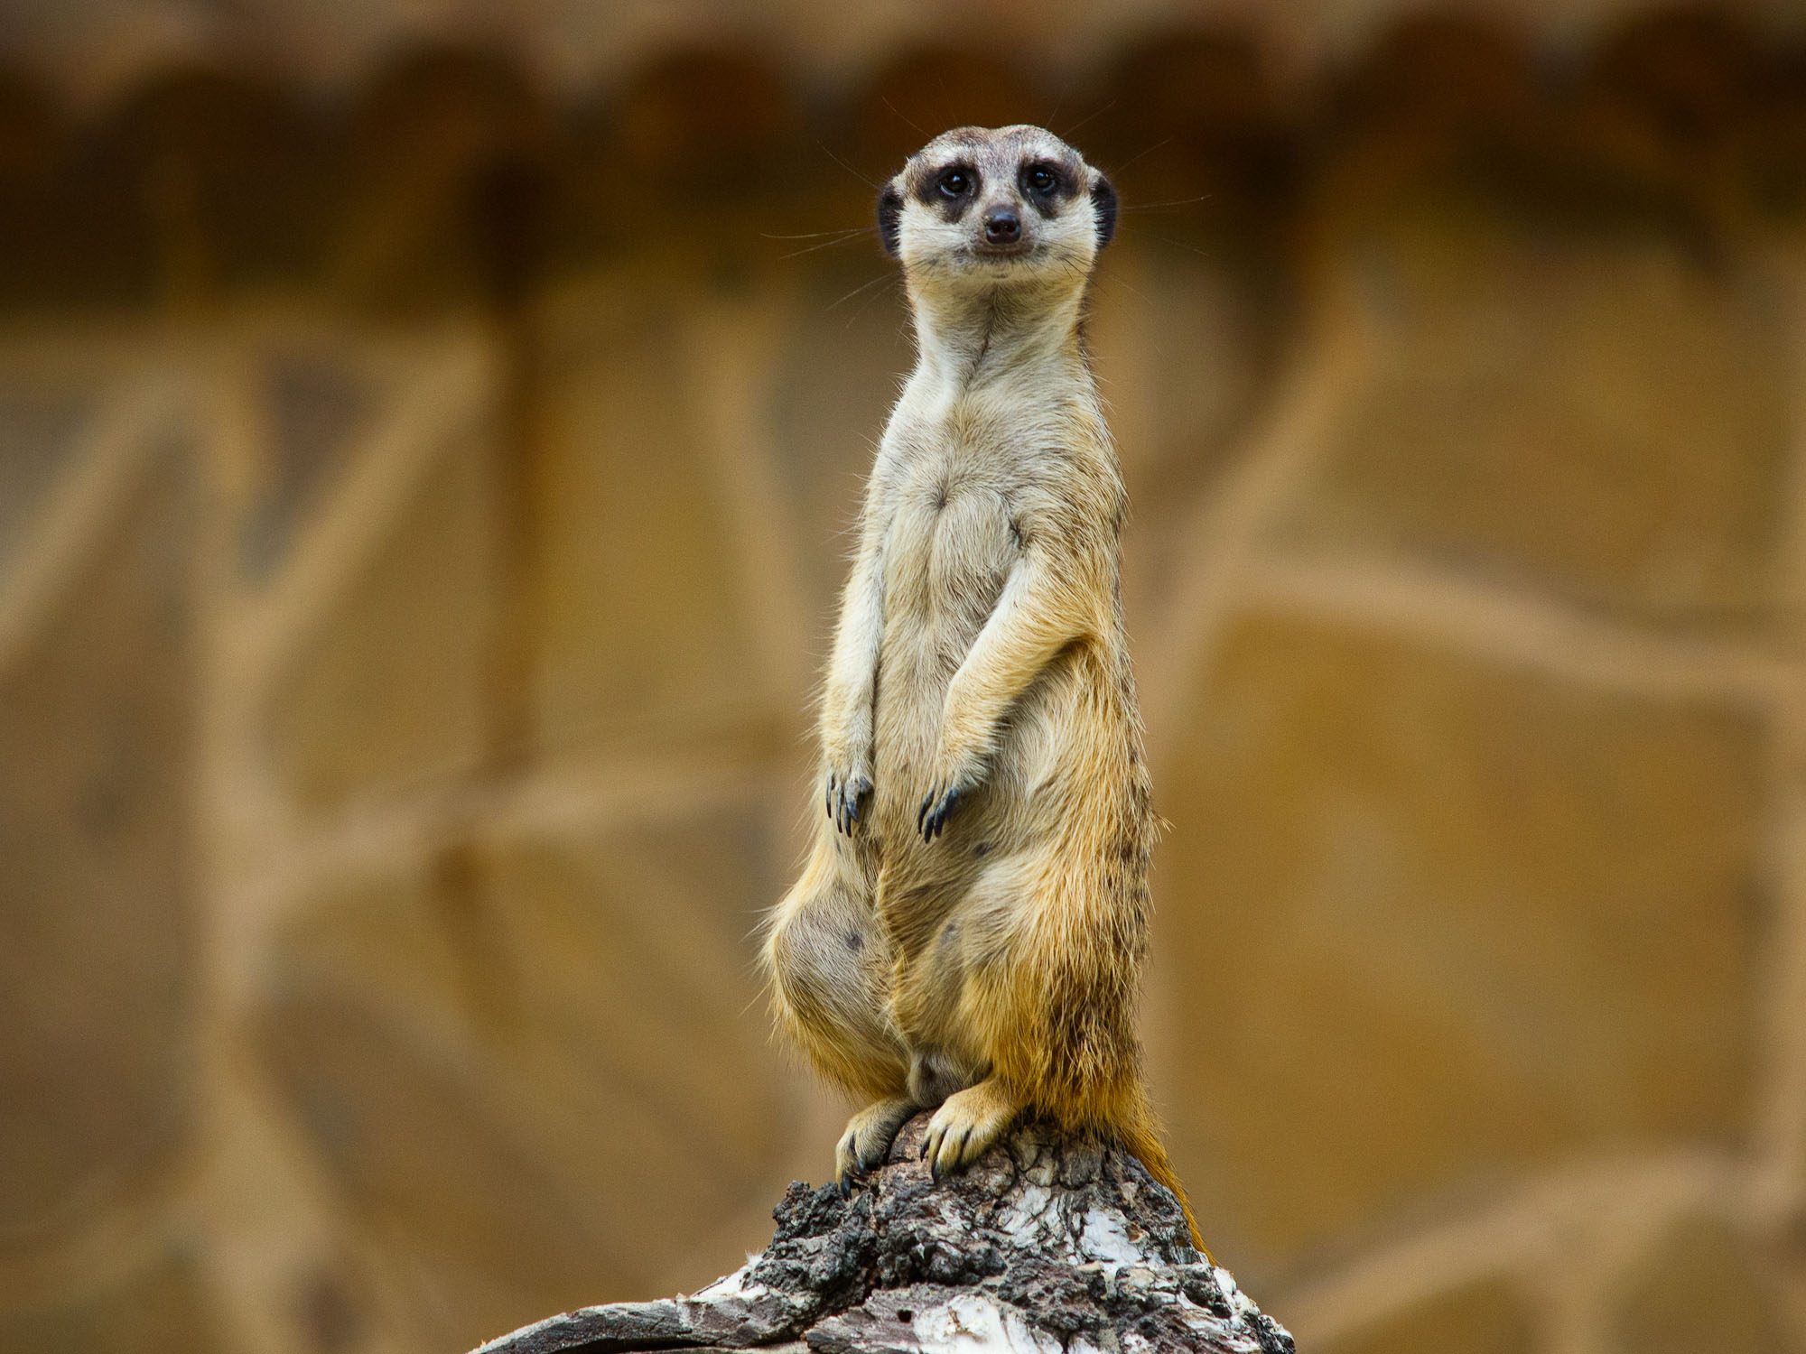
Move: Meerkat Pop
Notes:
https://upload.wikimedia.org/wikipedia/commons/f/f7/Meerkat_At_the_zoo_Novosibirsk_Siberia.jpg

Slide 12
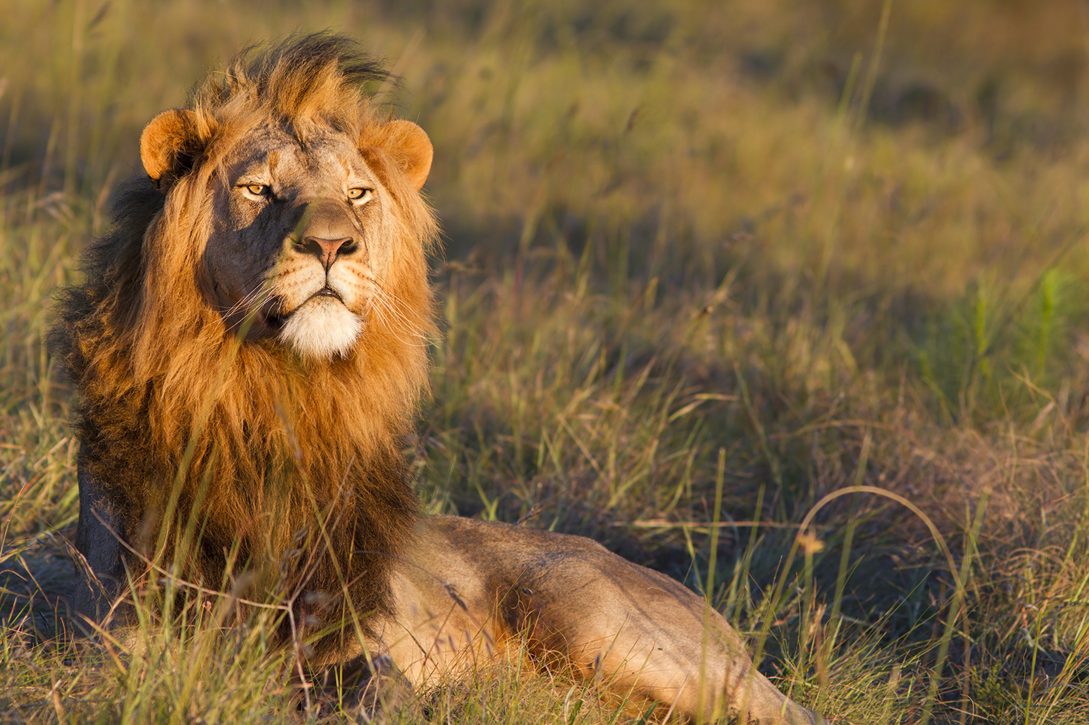
Move: Lion Play
Notes:
https://www.google.com/search?q=lion&source=lnms&tbm=isch&sa=X&ved=0ahUKEwjrhNjAy4XOAhUT3mMKHXuuBMkQ_AUICCgB&biw=1280&bih=879#imgrc=z2Em6PTkG-QHiM%3A

Slide 13
Freestyle!

Slide 14
Great job!

